Slide 1
Comparing Old Cone vs. New Cone on PP1,PP2,PP6,and Demo PP
Brian C

Slide 2
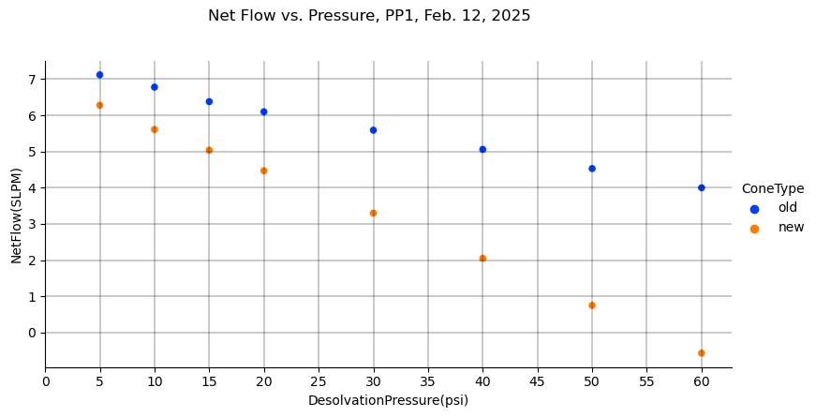

Slide 3
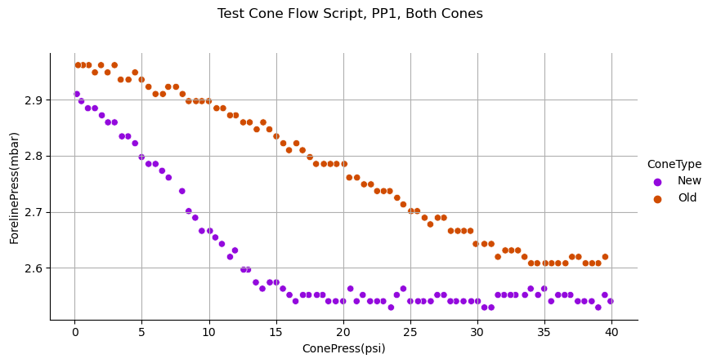

Slide 4
Foreline Stabilization for Script – PP1
Old Cone
New Cone

Slide 5
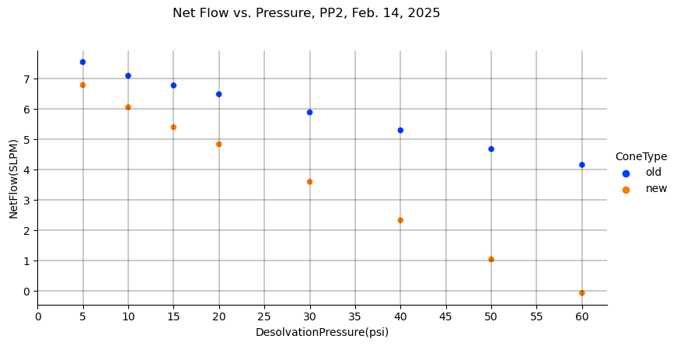

Slide 6
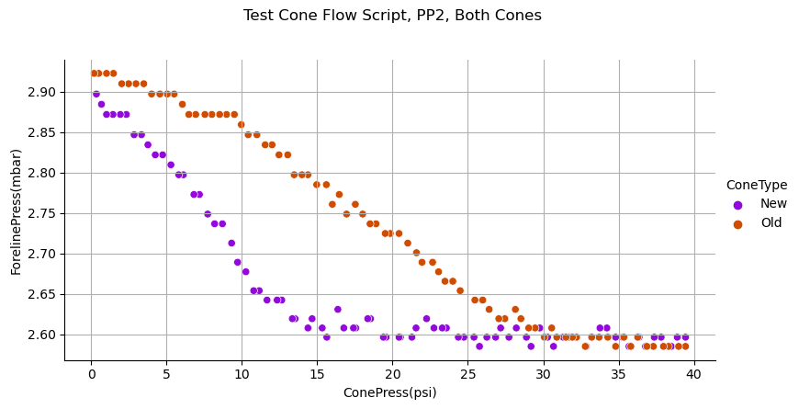

Slide 7
Foreline Stabilization for Script – PP2
Old Cone
New Cone

Slide 8
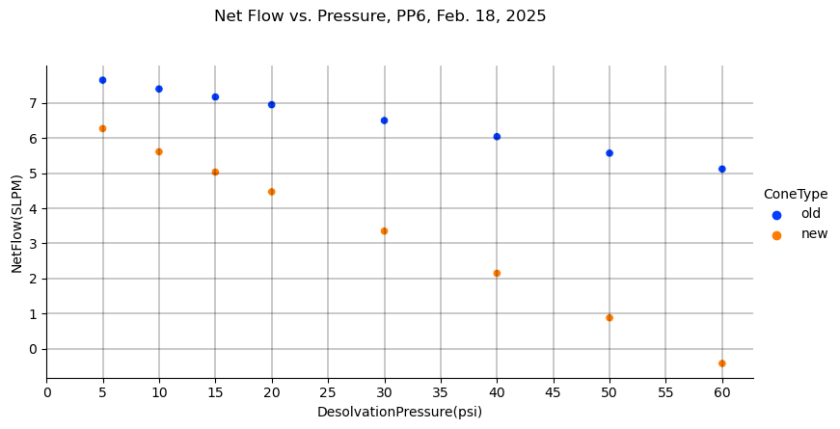

Slide 9
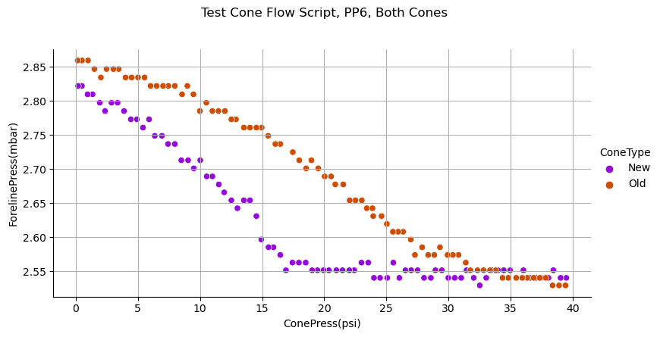

Slide 10
Foreline Stabilization for Script – PP6
Old Cone
New Cone

Slide 11
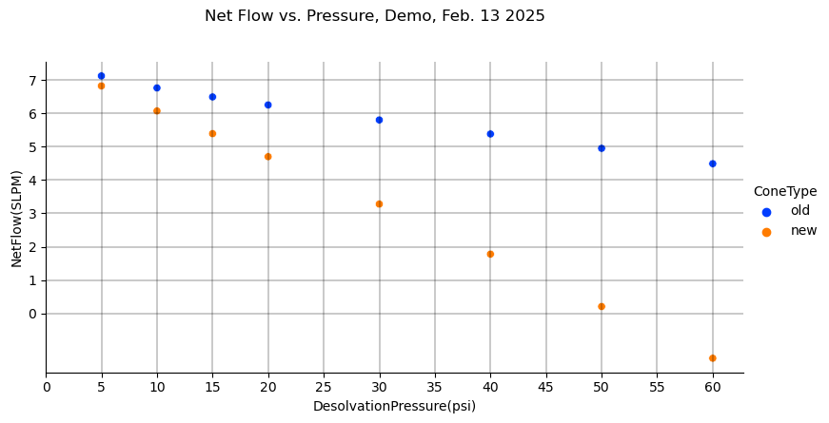

Slide 12
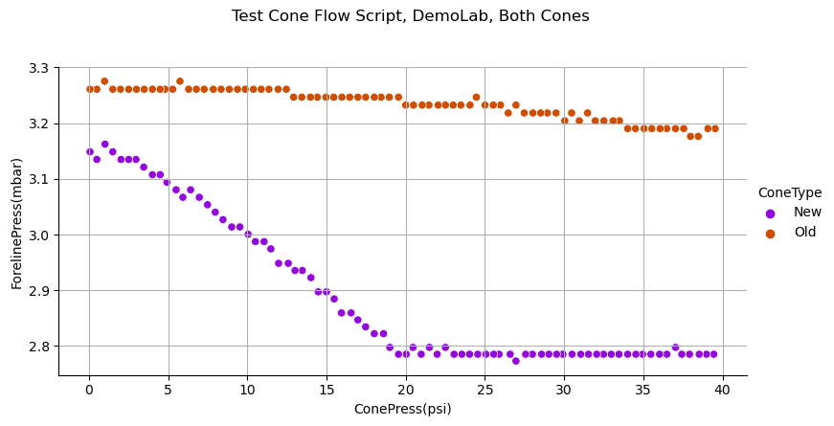

Slide 13
Foreline Stabilization for Script – Demo Unit
Old Cone
New Cone

Slide 14
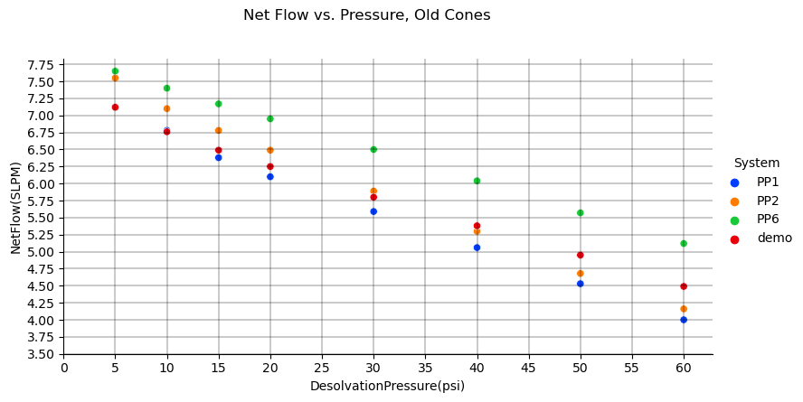

Slide 15
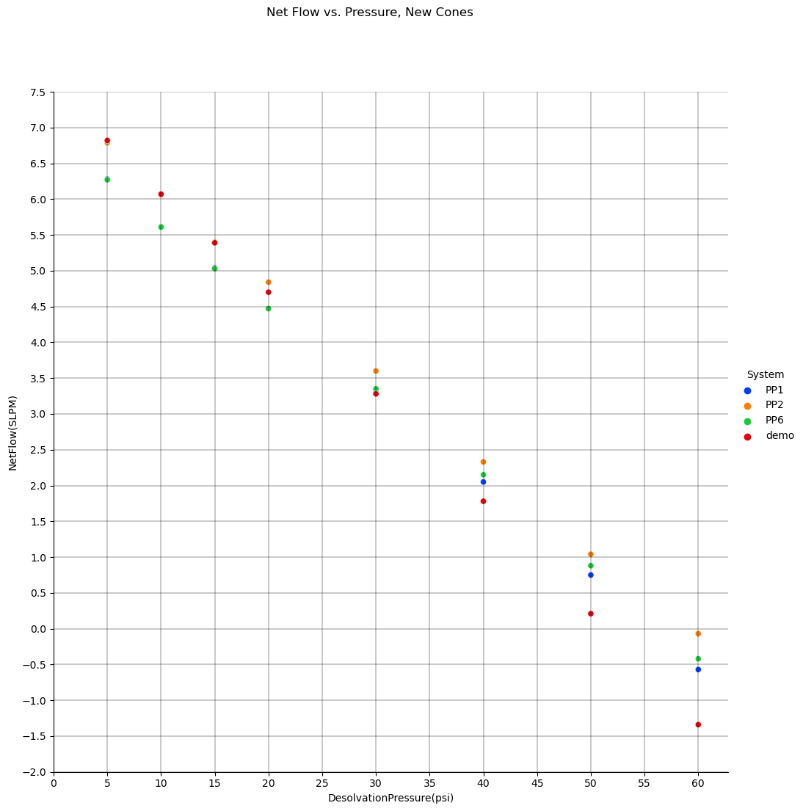

Slide 16
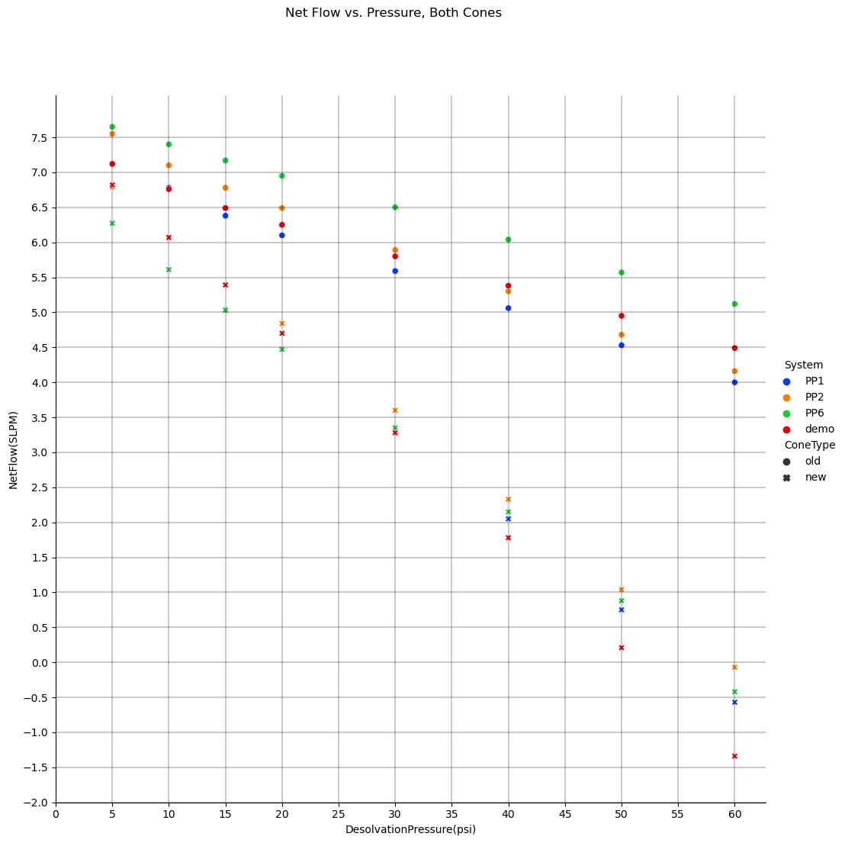

Slide 17
